Slide 1



Coordination in Distributed Multi-User High-Performance Dense Networks (5G Synchronization: October Update)

Slide 2
Outline
Recap
By utilizing coherence bandwidth, pilot-assisted phase-noise / channel estimation is possible.
Propose Method for Phase Noise Cancellation
1st step: PN (phase-noise)-affected channel estimation
2nd step: Deconvolution
3rd step: ICI (intercarrier interference)-free channel estimation
Pilot Overhead Analysis
Resource allocation
Numerical result
Conclusion/Future plan

Slide 3
Recap

Slide 4
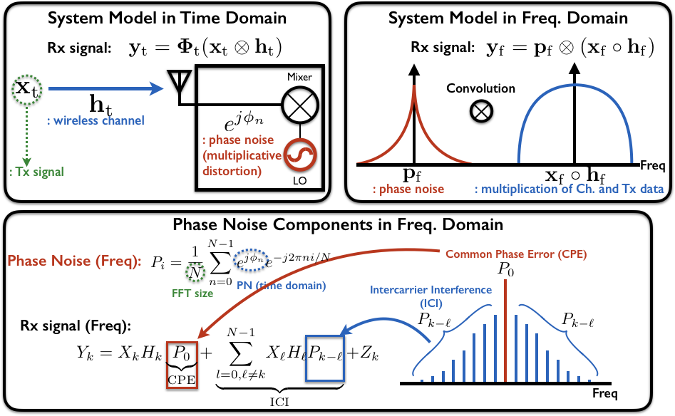
Background: System Model with Phase Noise (PN)

Slide 5
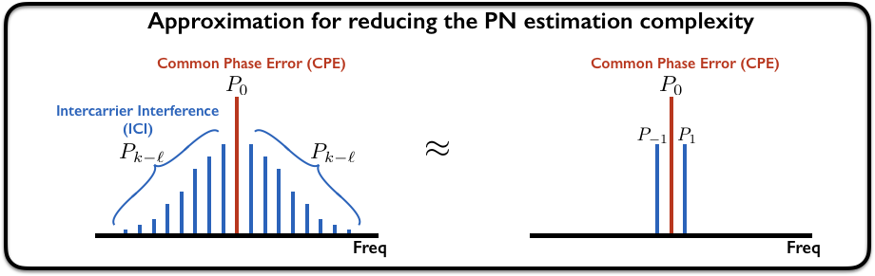
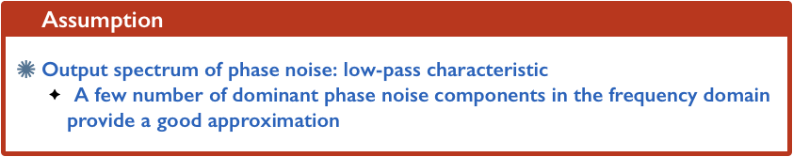
Background: Approximation of Phase Noise Spectrum

Slide 6
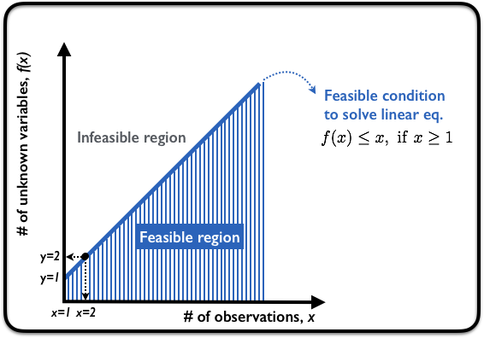
Background: Feasibility for Pilot-assisted Estimation

Slide 7
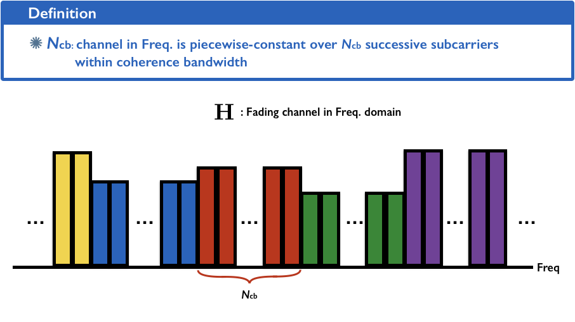
Our Idea: Utilizing Coherence Bandwidth

Slide 8
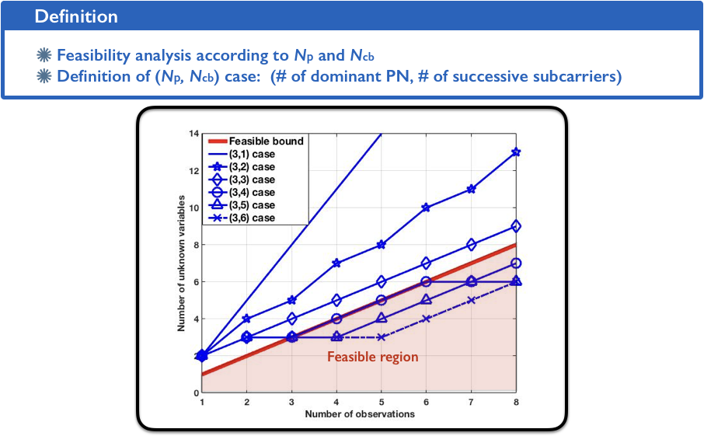
Out Idea: Estimation of Combination of CH and PN

Slide 9
Proposed Method

Slide 10
What is the Key Strategy for PN Cancellation?
1st step: Estimation of Phase-Noise (PN)-Affected Channel
- Estimation by using PN-dedicated pilot
2nd step: Separation of CH and PN components
- Deconvolution
3rd step: Estimation of Intercarrier Interference(ICI)-Free Channel
- Estimation by using ICI-dedicated pilot

Slide 11
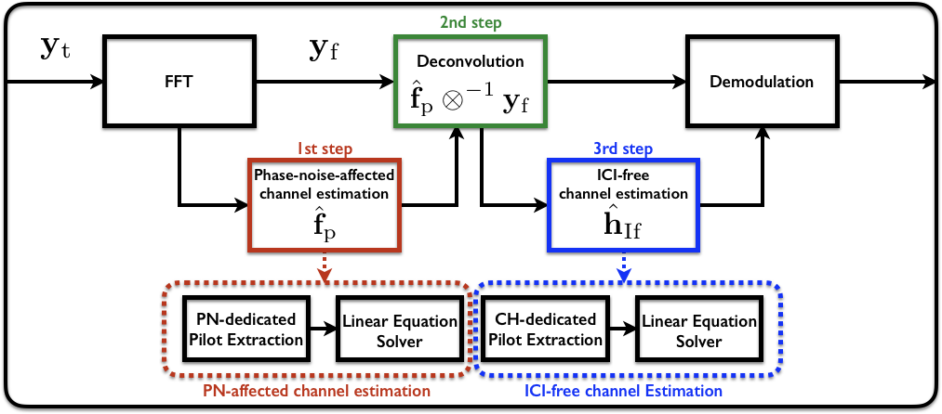
Overall Architecture

Slide 12
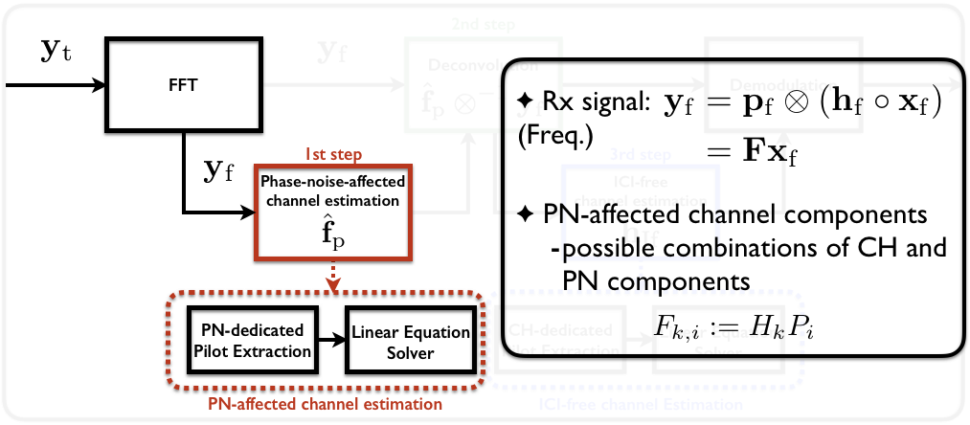
1st Step: Estimation of PN-Affected Channel

Slide 13
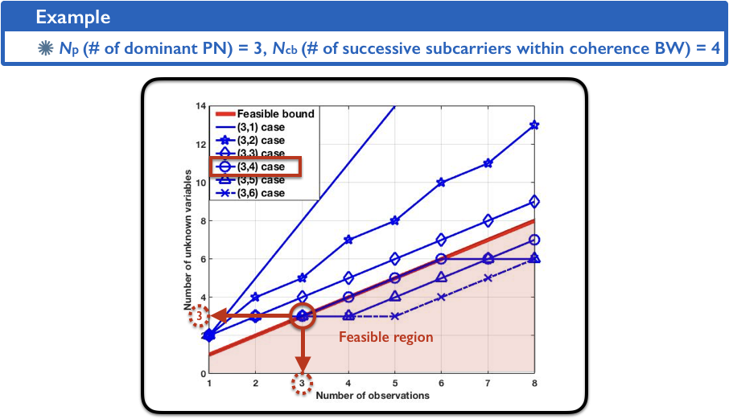
1st Step: Estimation of PN-Affected Channel

Slide 14
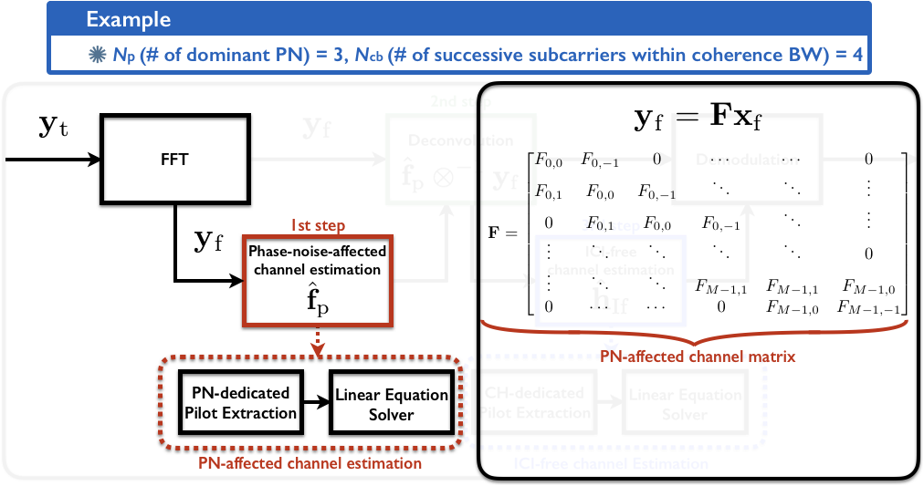
1st Step: Estimation of PN-Affected Channel

Slide 15
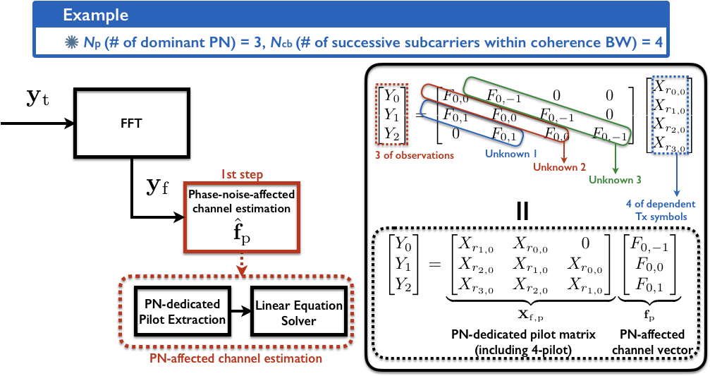
1st Step: Estimation of PN-Affected Channel

Slide 16
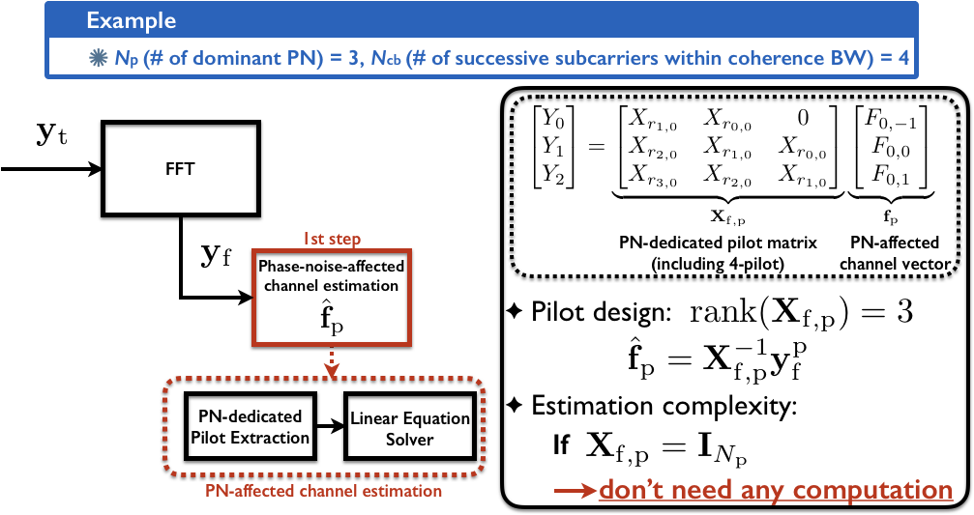
1st Step: Estimation of PN-Affected Channel

Slide 17
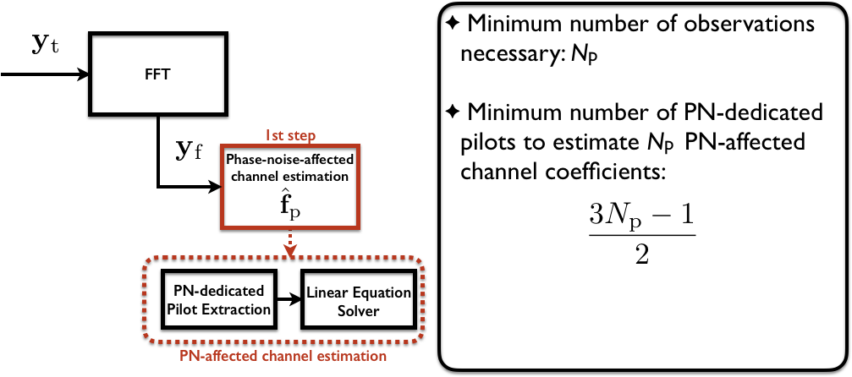
1st Step: Estimation of PN-Affected Channel

Slide 18
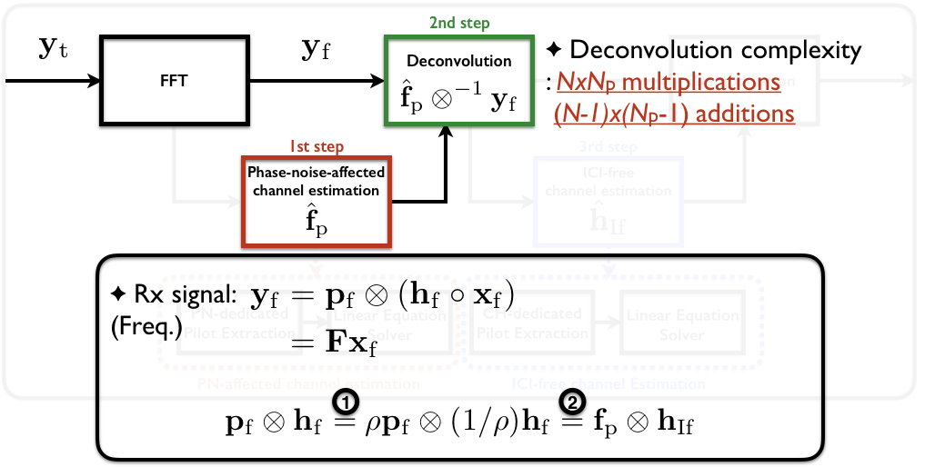
2nd Step: Separation of CH and PN components

Slide 19
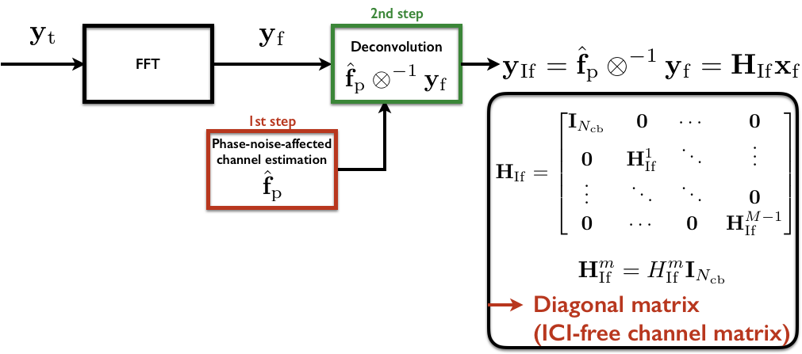
2nd Step: Separation of CH and PN components

Slide 20
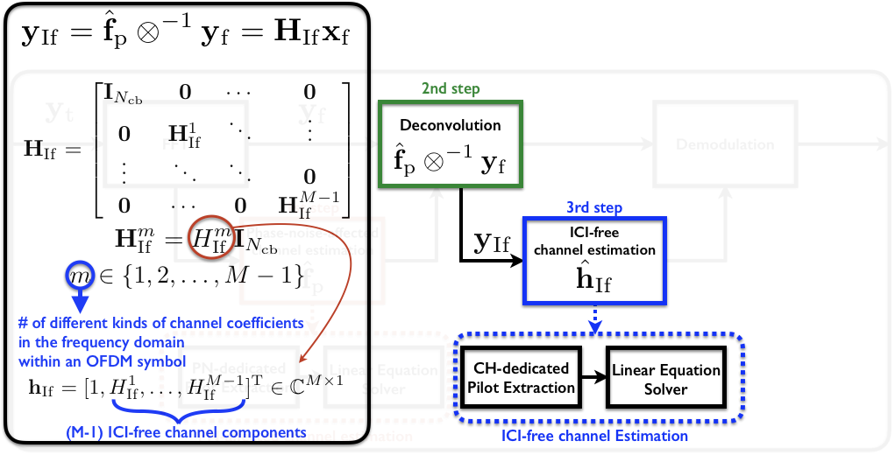
3rd Step: Estimation of ICI-Free Channel

Slide 21
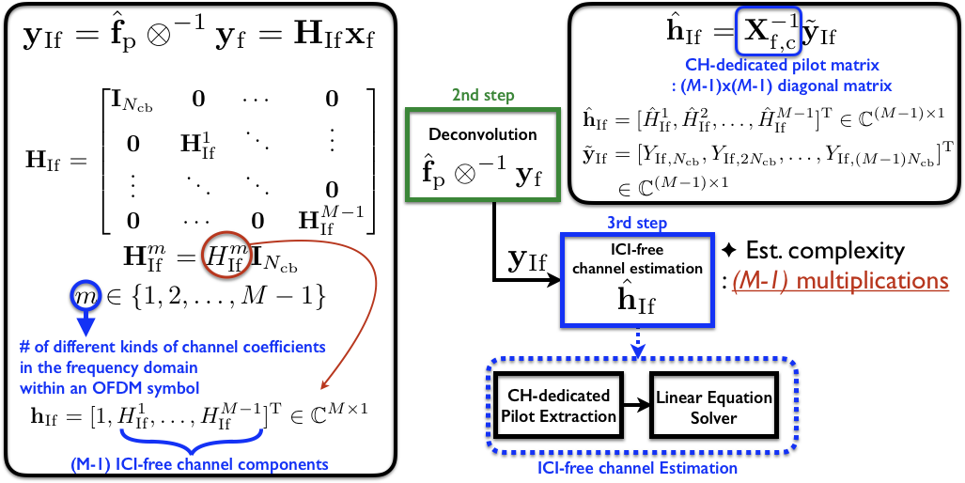
3rd Step: Estimation of ICI-Free Channel

Slide 22
Pilot Overhead Analysis

Slide 23
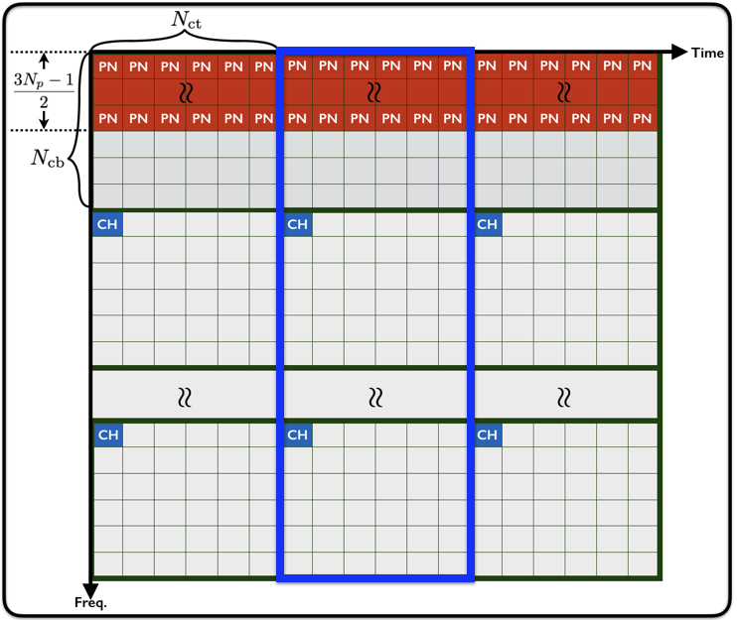
Resource Allocation

Slide 24
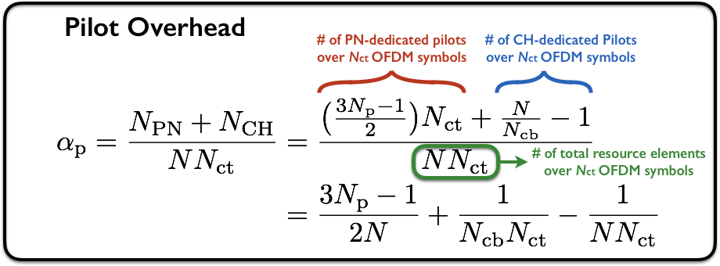
Overhead Analysis

Slide 25
Conclusion
Cancellation of Np predominant phase noise components
Channel coherence structure with Ncb more than (3Np-1)/2
(3Np-1)/2 pilots
Under channel coherence structure with Ncb
Ncb pilots
Maximum number of predominant phase noise components (freq.) can be cancelled by low-complexity linear processing
A conference paper (to be submitted)
Working title: Linear Phase Noise Cancellation for OFDM Systems
IEEE ICC 2019 (deadline: Nov. 14th 2018), IEEE SPAWC 2019 (deadline: Feb. 19.th 2019), IEEE VTC 2019(deadline: Feb. 25th 2019)
Spectral Efficiency Analysis / Trade-off between pilot overhead and SINR

Slide 26
Thanks!

